Slide 1

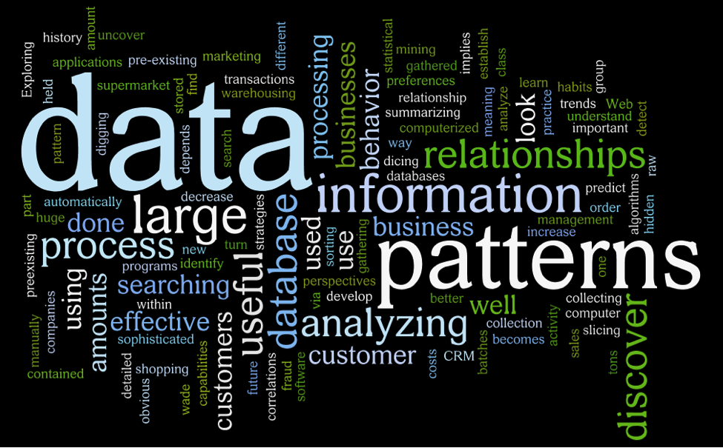


DATA
MINING

Slide 2
Outline
What is data mining?
Applications
Techniques
Advantages
Drawbacks

Slide 3
Data mining [KDD]
(Knowledge discovery from databases)

Slide 4
What is data mining?
State the problem you are solving in one or two sentences.
Data mining is extracting useful information, insights and patterns from a very large data sets or data warehouse, the web or other massive data streams. This extraction is done using combining statistics and machine learning methods. Overall goal is to extract information and transform it for further use.

Slide 5
Applications
COMMUNICATIONS
INSURANCE
EDUCATION
MANUFACTURING
BANKING

Slide 6
RETAIL
E-COMMERCE
SUPERMARKET
CRIME INVESTIGATION
BIOINFORMATICS
TRADING

Slide 7
Data mining
Flowchart
1

Slide 8
UNDERSTANDING BUSINESS PROBLEMS
1
DATA UNDERSTANDING
2
DATA PREPARATION
3
DATA MINING TECHNIQUES.
4
INTERPRETATION
5

Slide 9
UNDERSTANDING BUSINESS PROBLEMS
Understand the business and client objectives to be met.
Get the scenario of the business and the data you would need.
Detailed planning of the requirements.

Slide 10
DATA
UNDERSTANDING
Analysis the source of data
The nature of data understanding
Detail it contains and the detail you need to be distinguished.

Slide 11
DATA
PREPARATION
cleaning unwanted data noises, like,
- Duplicates
-Missing values
-Outliers
-Unwanted /non-significant data

Slide 12
DATA MINING
TECHNIQUES
Machine learning algorithm can be used to mine i.e. to get pattern from data:
1. C4.5 Algorithm
2. K-mean Algorithm
3. Support Vector Machines
4. Apriori Algorithm
5. Expectation-Maximization Algorithm
6. PageRank Algorithm
7. Adaboost Algorithm
8. kNN Algorithm
9. Naive Bayes Algorithm
10. CART Algorithm

Slide 13



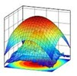














DATA MINING
TOOLS

Slide 14








R
Python
Rapid miner
SAS Data mining
Teradata
BOARD
Dundas
Inetsoft
H3O
Qlik
Oracle BI
KNIME
Tangra
Solver
Sisense
Data Melt
ELKI
SPMF
Alteryx
Enterprise Miner
Data watch
Advanced miner
Analytic Solver
PoltAnalyst
Civis
Viscovery

Slide 15
INTERPRETATION
Data can be interpreted with data visualization tools and dashboards since raw algorithm results cannot be understood by the clients.
The results need to be evaluated and should be understandable before interpretation.
This helps the companies to get a knowledge-based information.

Slide 16
Advantages
Helps to collect reliable informations.
Business strategies and improvement could be planned and foreseen.
Help to detect and control risks and crimes.
Helps to improve product safety.
It helps to quickly initiate automated predictions of behaviors and trends and discover hidden patterns.

Slide 17
THANK YOU!

